Slide 1
Written Character Classification using a Convolutional Neural Network (CNN)
By John Nguyen and Saif Billah
EECE 5644: Introduction to Machine Learning

Slide 2
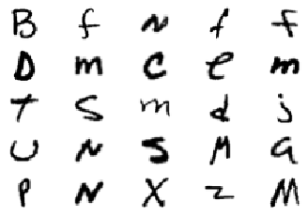
Introduction
Written Character Classification Applications
Automatically convert handwritten forms to editable documents
Digitize handwritten notes for easier access and future editing
Automate processes that require reading text and performing an action based on that information (sending a letter, etc)

Slide 3
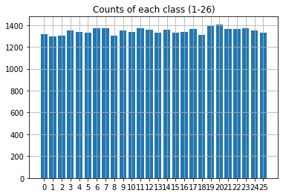
EMNIST Dataset
Handwritten characters (28x28x1 -> 28x28 pixels, grayscale)
Subset: 50,000 characters, 26 Classes
Training/Validation/Test
70/20/10 %

Slide 4

Why use a CNN?
Images have little relation between unique pixels unless those pixels are close to each other.
A CNN can be more efficient than a regular Neural Net because it can take advantage of this.

Slide 5
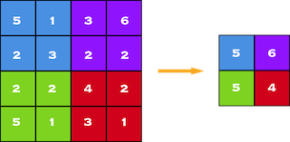
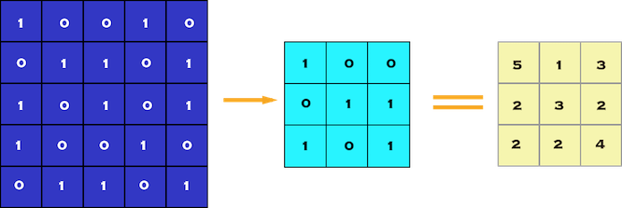
Convolution and Pooling Layers
Convolution is used to extract features by filtering the image with a smaller pixel filter to decrease the size but maintain the relationship between pixels
Pooling is used to further reduce the number of parameters which reduces the computational complexity
Convolution Example (5x5 image with 3x3 filter)
Max Pooling by 2x2

Slide 6

Our CNN Layers
Convolutional
Leaky ReLU
Convolutional
Leaky ReLU
MaxPool
Convolutional
Leaky ReLU
Convolutional
Leaky ReLU
MaxPool
Classification (Linear Transformation 3x)

Slide 7
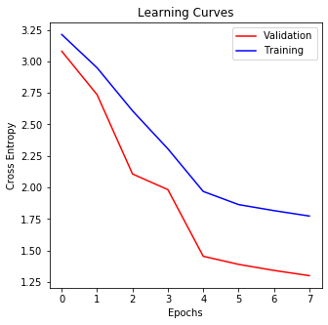
Training and Validation
70/20/10 splits
SGD vs Adam Optimization?
SGD overshoots
Adam uses 1st and 2nd moments to dampen through adaptive learning rate

Slide 8
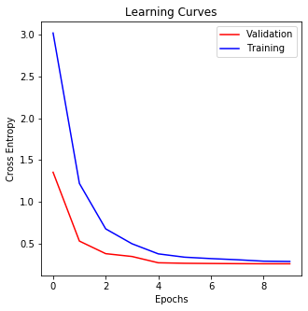
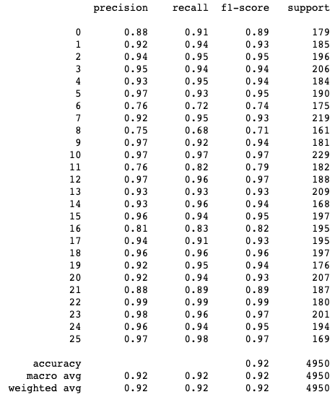
Classification Report

Slide 9
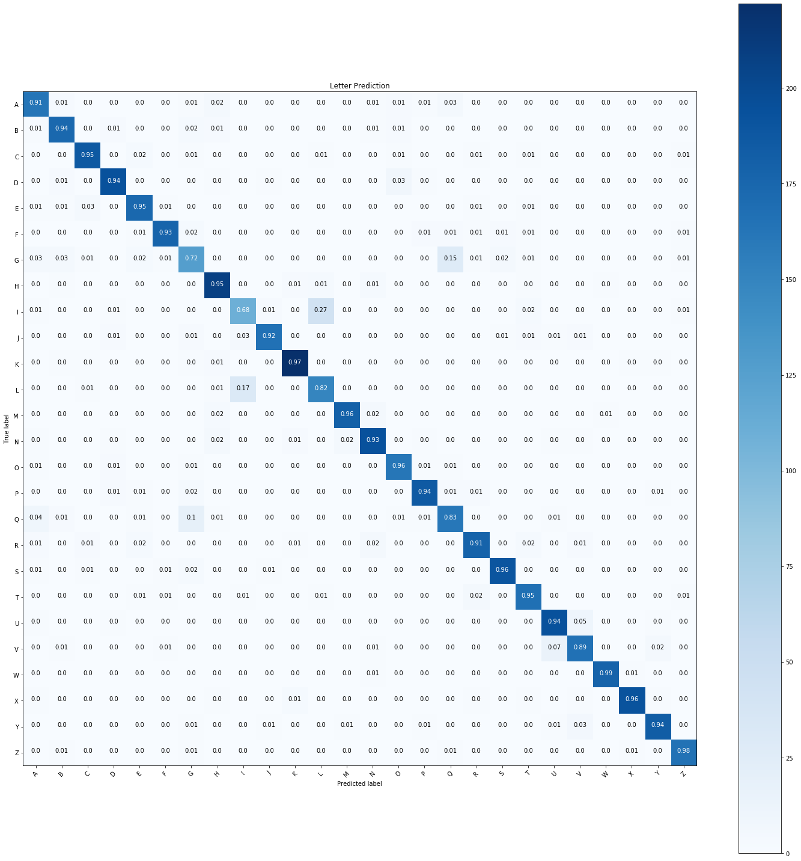
Confusion Matrix
Confusion Matrix of CNN on Test Dataset

Slide 10
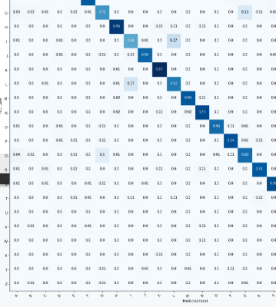
Confusion Matrix
Most commonly misclassified letters:
L and I
Q and G

Slide 11
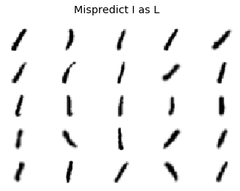
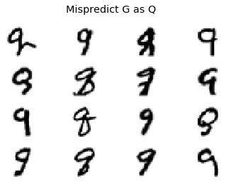
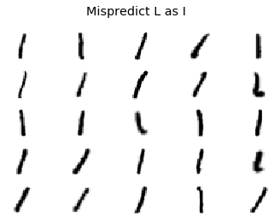
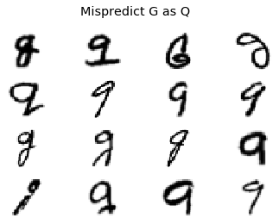
Misclassified Letters

Slide 12
Future Work
Try to improve character classification on “L”, “I”, “G”, “Q” and other similar-looking letters
Learn how to classify words
Improvements: Create a model that predicts characters by taking into account the surrounding characters and possible word choices
Mimic human action of how we classify words using our previous knowledge of other words

Slide 13
Thank You!
Questions?

